Slide 1


Slide 2
Contributors
Joel the Hybrid destroyer
DevFender the nomad and memelord
Katos the hybrid expert

Slide 3
What is CloudHour?
Objective of CloudHour
Round-table discussion
Focus on a few key topics
Why It's Important
Rapid changes in cloud security and tech
Stay updated and connected for growth as community
How it will benefit the community
Real-time engagement with hosts and community members
Ask open questions and speak your opinion
Opportunity to affect the next agenda
Notes:
Objective of CloudHour
The objective of CloudHour is to create a collaborative space where professionals can come together to discuss, learn, and share insights on the most pressing topics in cloud security and modern workplace technology.
Why its important
CloudHour is important because, in the rapidly evolving landscape of cloud security and workplace technologies, staying updated and connected is crucial for career growth and organizational resilience
How it will benefit the community
By attending CloudHour, community members will have the unique opportunity to engage with industry experts in real-time, ask questions, network with like-minded professionals, and even have the chance to contribute their own expertise by becoming guest speakers in future episodes.

Slide 4

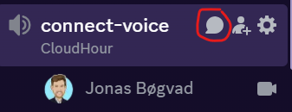
If you prefer to not talk or be asked questions press mute
press mute just mute the mic
If you preferer to chat press

Slide 5
State of the server

Slide 6
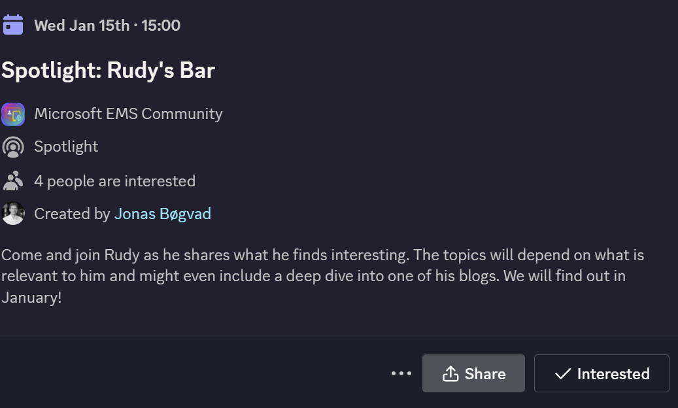
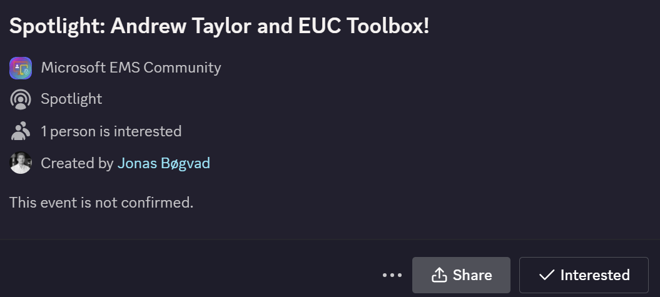
Spotlights sessions
OSD Cloud​
IntuneCD​ (reached out)
Rudy Webinar ​
Johan Arwidmark ​
Purav (reached out)
Kelvin from CIPP ​
Andrew Taylor and EUC Toolbox (Date need to be confirmed)
TUGI tool (reached out)
WinTuner Stephan van Rooji

Slide 7
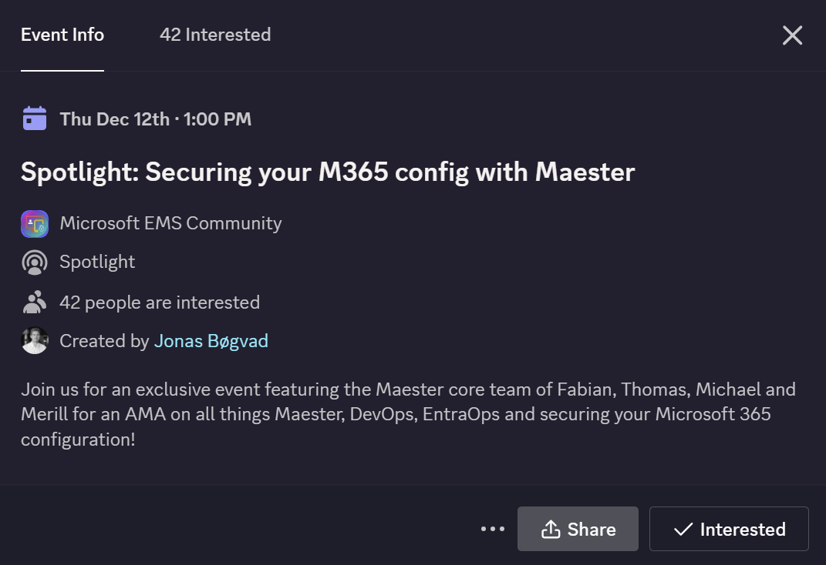
Spotlights sessions
OSD Cloud​
IntuneCD​
Rudy Webinar (From Lewis)​
Johan Arwidmark (From Matt)​
Purav (from Dev)​
Kelvin from CIPP (From Lewis)​
Andrew Taylor (from Dev)​
TUGI tool (from Joel)​
WinTuner Stephan van Rooji (from Dev)

Slide 8
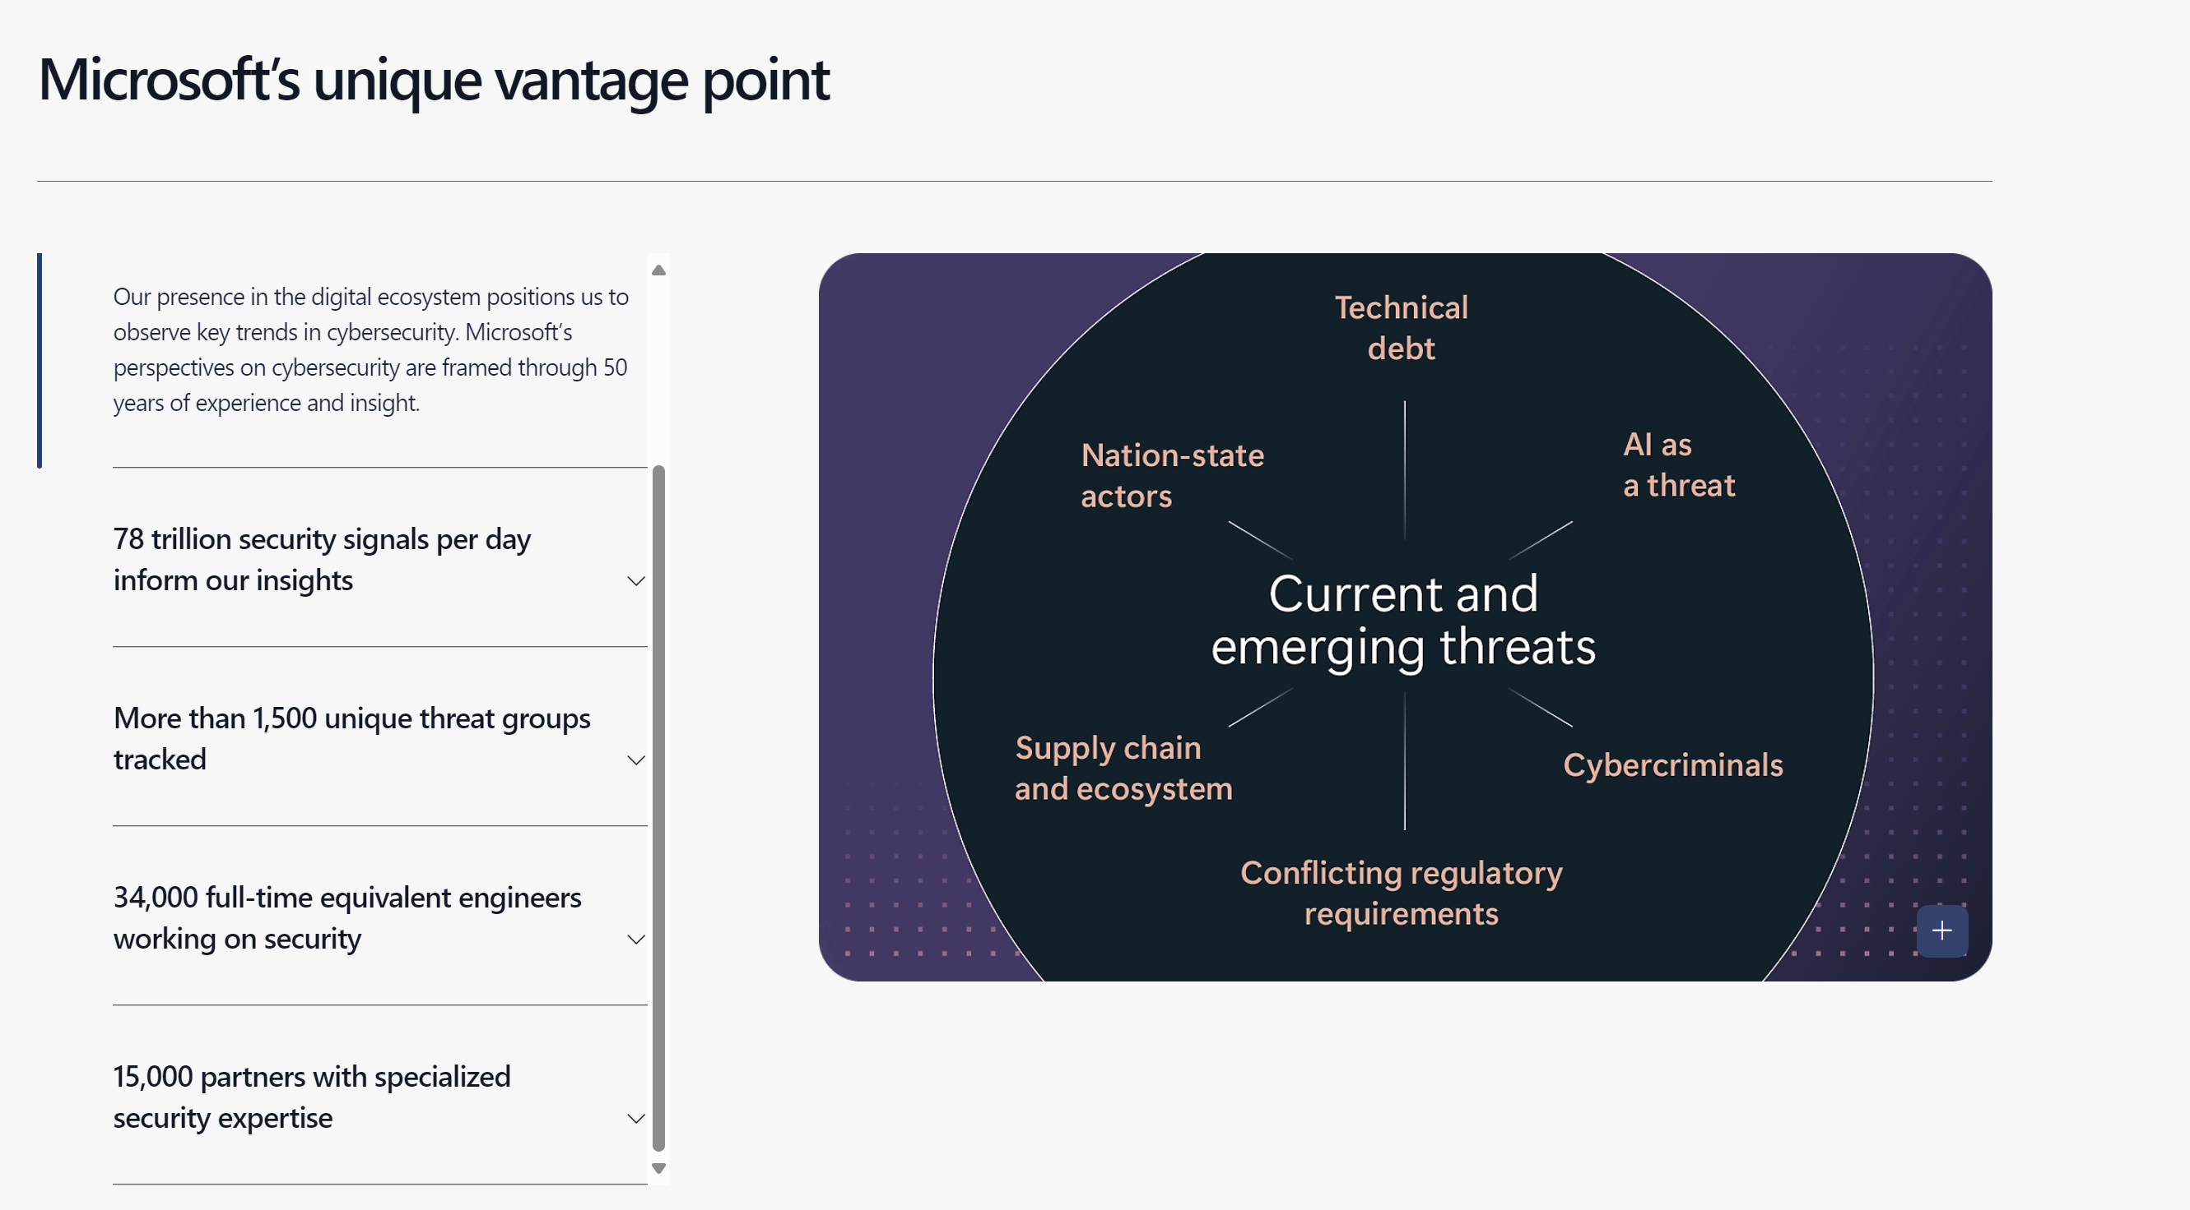
Microsoft Digital Defense Report 2024
Notes:
https://www.microsoft.com/en-gb/security/security-insider/intelligence-reports/microsoft-digital-defense-report-2024?msockid=3bef1be87261641b09e20845732c65d6#modal-dialog

Slide 9
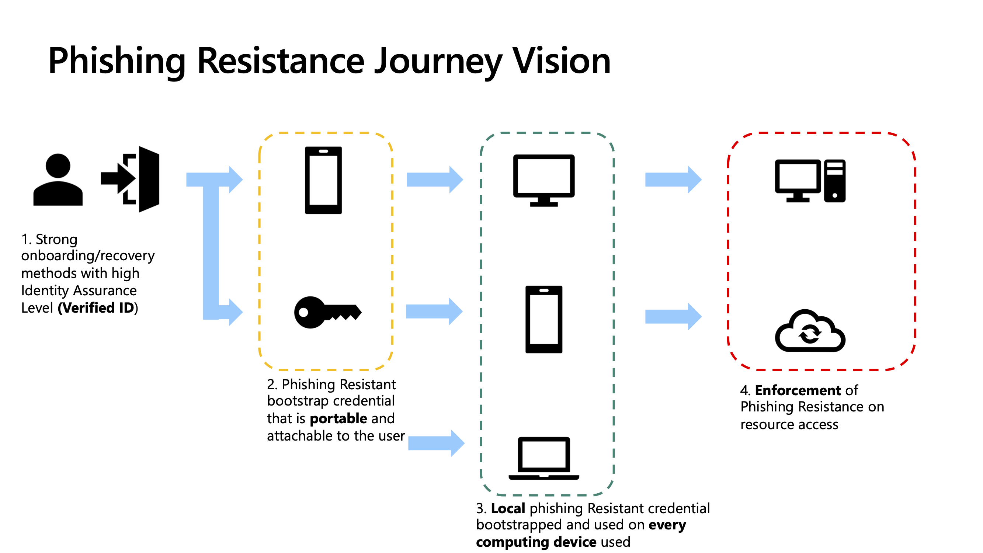
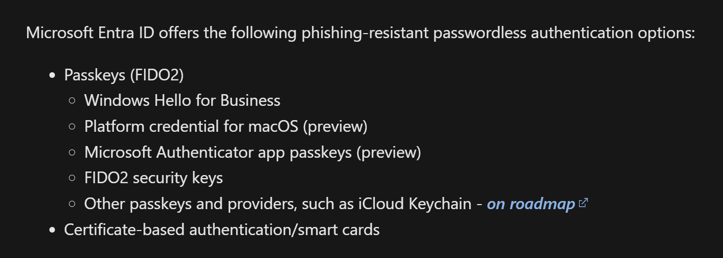
Get started with phishing-resistant passwordless authentication
Notes:
https://learn.microsoft.com/en-us/entra/identity/authentication/how-to-plan-prerequisites-phishing-resistant-passwordless-authentication

Slide 10
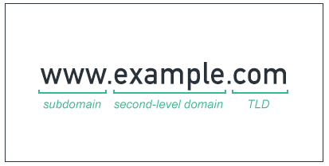
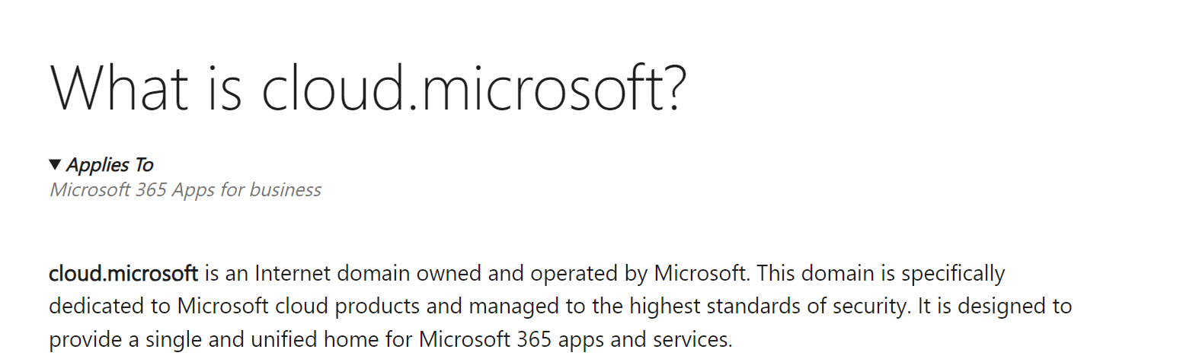
Domain changes!
Prepare your env for https://cloud.microsoft/
M365.cloud.Microsoft
Outlook.cloud.Microsoft
Notes:
https://support.microsoft.com/en-us/office/what-is-cloud-microsoft-7ba4c8b9-d062-4444-84a5-fca6c3006d2b

Slide 11
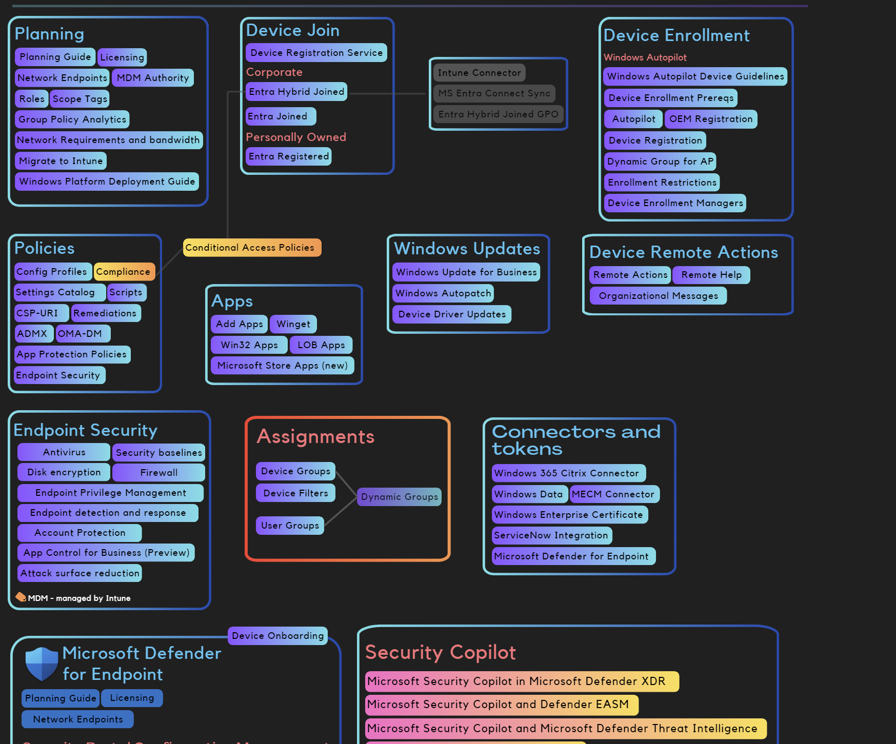
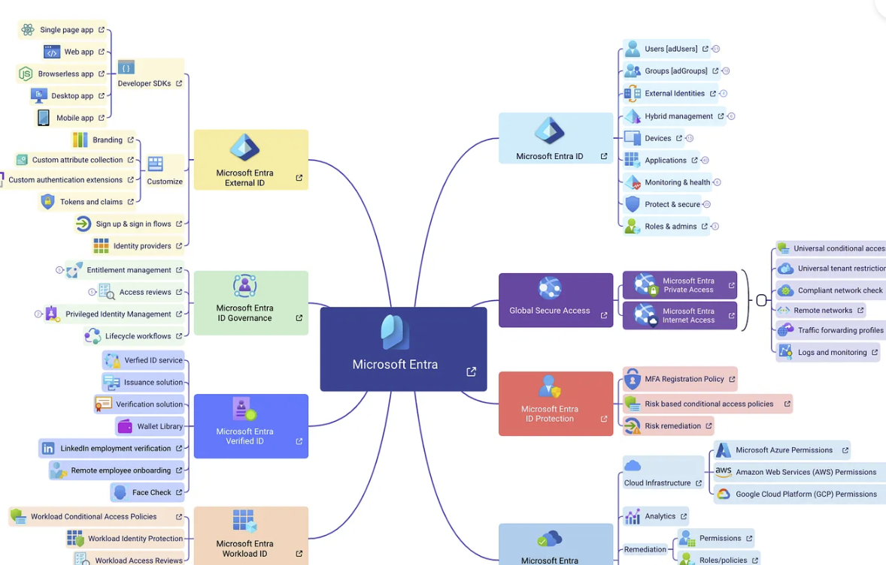
Mind Maps
Intune Mind Map by Shehan
Entra Mind Map by merill
Notes:
https://entra.news/p/entra-mind-maps

Slide 12
Agenda
Microsoft Defender for Cloud Apps
Global Secure Access
Microsoft Intune device attestation

Slide 13
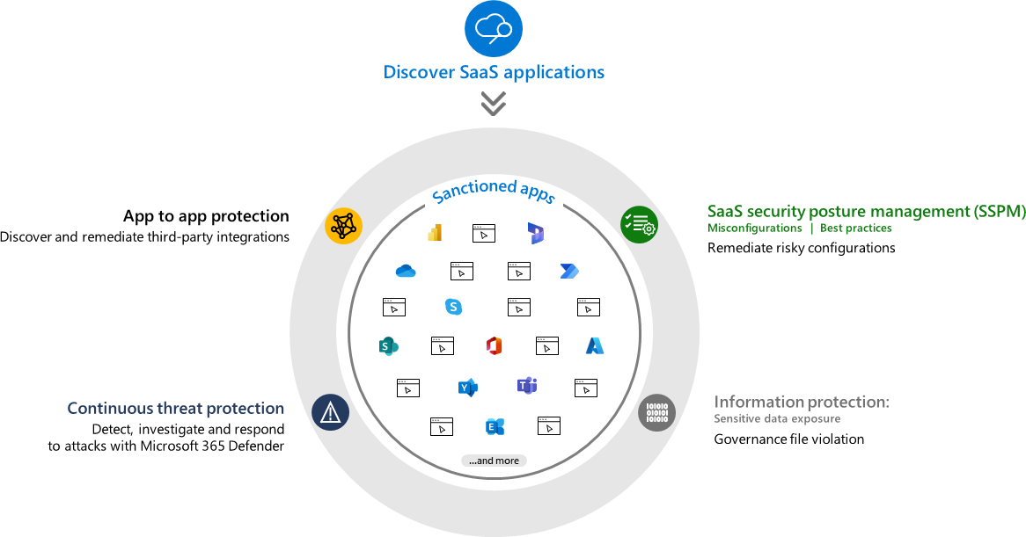
Microsoft Defender for Cloud Apps
What are the top benefits of using Microsoft Defender for Cloud Apps in securing cloud environments?
How do you see Cloud App Security influencing your overall cloud strategy?
Have you found Microsoft Defender for Cloud Apps effective in detecting shadow IT? If so, how?

Slide 14
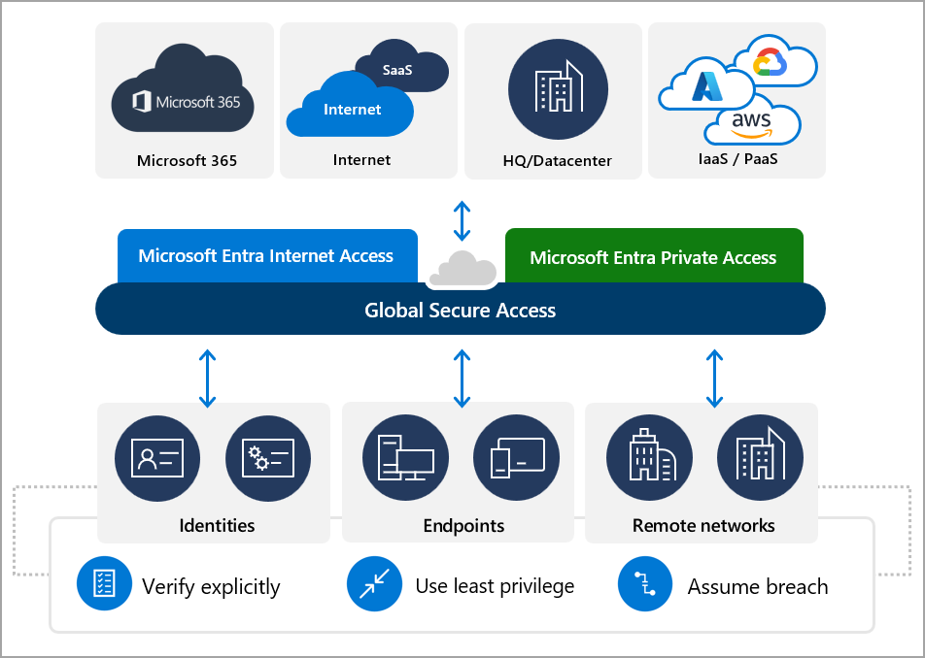
Global Secure Access
What is your overall impression of Microsoft Global Secure Access and its role in Zero Trust security?
How does Global Secure Access compare to other secure access solutions you’ve used?
What do you think is the most critical feature of Global Secure Access in enabling secure hybrid work environments?
Universal Continuous Access Evaluation

Slide 15
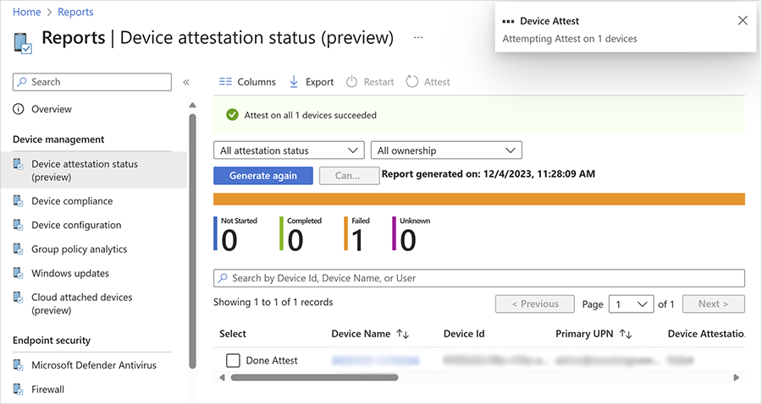
Microsoft Intune device attestation
Requires a device to be hardware-attested so that you can verify that a device is securely enrolled
You can then use a new status report to manage your organization’s attestation status overall and at the individual device level

Slide 16
Universal Continuous Access Evaluation (preview)
Tool to add into the Token theft prevention scenario.
Preq
Conditional Access understanding
Network fundamentals
Tokens fundamentals (to understand the benefit)
Tool to prevent token theft
Global Secure Access detects user identity changes in near real time and prompts reauthentication via a claims challenge, even with a valid access token.
Video by John Savil (https://www.youtube.com/watch?v=m3309aUKET8)
Notes:
https://learn.microsoft.com/en-us/entra/global-secure-access/concept-universal-continuous-access-evaluation
https://www.youtube.com/watch?v=m3309aUKET8

